Slide 1


Slide 2




Slide 3



QUEUE USING LINEAR LINKED LIST IN JAVA

Slide 4
WHY DO WE NEED A LINKED LIST?
Size of the array is fixed which is decided when we create an array so it is hard to predict the number of elements in advance
Array elements need contiguous memory locations to store their values
Inserting an element in an array is performance wise expensive as we have to shift several elements to make a space for the new element
Deleting an element from the array is also a performance wise expensive operation because all the elements after the deleted element have to be shifted left
If the declared size fall short then we cannot increase the size of an array and if we declare a large size array and do not need to store that many elements then it is a waste of memory

Slide 5
ADVANTAGES OF LINEAR LINKED LIST
Linked list allows dynamic memory allocation, which means memory allocation is done at the run time by the compiler and we do not need to mention the size of the list during linked list declaration
Linked list elements don’t need contiguous memory locations because elements are linked with each other using the reference part of the node that contains the address of the next node of the list
Insert and delete operations in the Linked list are not performance wise expensive because adding and deleting an element from the linked list does’t require element shifting, only the pointer of the previous and the next node requires change

Slide 6
WHAT IS LINEAR LINKED LIST?
Linked List are linear data structures where the elements are not stored in contiguous locations and every element is a separate object with a data part and address part
The elements are linked using pointers and addresses
Each element is known as a node
To store the elements in a linked list we use a doubly linked list which provides a linear data structure and also used to inherit an abstract class and implement list and deque interfaces
In Java, LinkedList class implements the list interface

Slide 7
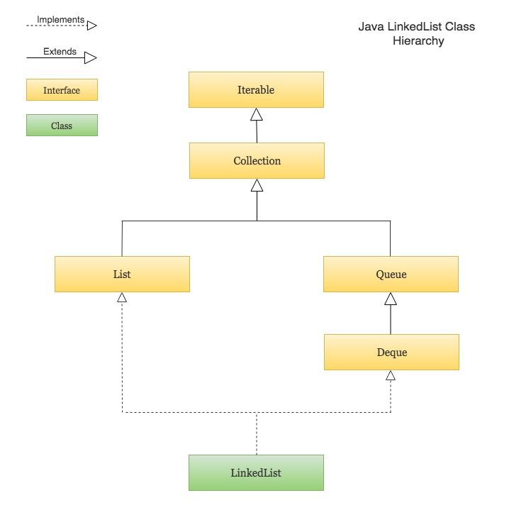
HIERARCHY OF LINKEDLIST CLASS
Notes:
But the problem with this approach, is if we have more teams like England or New Zealand, then we have to create more variables and hence increasing its complexity. To add to that when ever we have more teams, we have to modify the code and compile it.

Slide 8

LINKED LIST IMPLEMENTATION OF QUEUE
In linked list implementation of a queue, the last inserted node is always pointed by 'rear' and the first node is always pointed by 'front'
In above example, the last inserted node is 50 and it is pointed by 'rear' and the first inserted node is 10 and it is pointed by 'front'. The order of elements inserted is 10, 15, 22 and 50
Notes:
OUTPUT:
India = 200 Pak = 190 Aus = 210 Sri Lanka = 195
DESCRIPTION: This program creates an array of scores with size 4. The values (or elements) of the array are initialized using indices and later printed using indices.

Slide 9
STEPS TO IMPLEMENT QUEUE USING LINKED LIST
To implement queue using linked list, we need to set the following things before implementing actual operations
Step 1 - Include all the header files which are used in the program. And declare all the user defined functions.
Step 2 - Define a 'Node' structure with two members data and next.
Step 3 - Define two Node pointers ‘front’ and ‘rear’ and set both to NULL
Step 4 – Implement the main method by displaying menu of list of operations and make suitable function calls in the main method to perform user selected operation

Slide 10
PROGRAM TO IMPLEMENT QUEUE USING LINKED LIST
public class QueueUsingLinkedListMain { private Node front, rear; private int currentSize; // number of items //class to define linked node private class Node { int data; Node next; } //Zero argument constructor public QueueUsingLinkedListMain() { | front = null; rear = null; currentSize = 0; } public boolean isEmpty() { return (currentSize == 0); } public static void main(String a[]) { QueueUsingLinkedListMain queue = new QueueUsingLinkedListMain(); } }

Slide 11
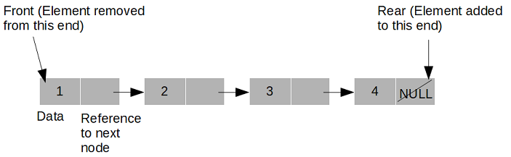
ENQUEUE(VALUE) - INSERTING AN ELEMENT INTO THE QUEUE
We can use the following steps to insert a new node into the queue
Step 1 - Create a newNode with given value and set 'newNode → next' to NULL.
Step 2 - Check whether queue is Empty (rear == NULL)
Step 3 - If it is Empty then, set front = newNode and rear = newNode
Step 4 - If it is Not Empty then, set rear → next = newNode and rear = newNode

Slide 12
PROGRAM TO INSERT AN ELEMENT INTO THE QUEUE
// Add data to the end of the list. public void enqueue(int data) { Node oldRear = rear; rear = new Node(); rear.data = data; rear.next = null; if (isEmpty()) { front = rear; } else { oldRear.next = rear; } currentSize++; System.out.println(data + " added to the queue"); } | public static void main(String a[]) { QueueUsingLinkedListMain queue = newQueueUsingLinkedListMain(); queue.enqueue(6); queue.enqueue(3); queue.enqueue(99); queue.enqueue(56); queue.enqueue(43); queue.enqueue(89); queue.enqueue(77); queue.enqueue(32); queue.enqueue(232); } }

Slide 13
DEQUEUE() - DELETING AN ELEMENT FROM QUEUE
We can use the following steps to delete a node from the queue
Step 1 - Check whether queue is Empty (front == NULL)
Step 2 - If it is Empty, then display "Queue is Empty!!! Deletion is not possible!!!" and terminate from the function
Step 3 - If it is Not Empty then, define a Node pointer 'temp' and set it to 'front'
Step 4 - Then set 'front = front → next' and delete 'temp' (free(temp))

Slide 14
PROGRAM TO DELETE AN ELEMENT FROM QUEUE
public class Test { public static void main(String[] args) { Queue q = new Queue(); q.enqueue(10); q.enqueue(20); q.dequeue(); q.dequeue(); q.enqueue(30); q.enqueue(40); q.enqueue(50); System.out.println("Dequeued item is " + q.dequeue().key); } }

Slide 15
MCQS IN QUEUE USING LINEAR LINKED LIST IN JAVA

Slide 16
QUESTION
In linked list implementation of queue, if only front pointer is maintained, which of the following operation take worst case linear time?
Insertion
Deletion
To empty a queue
Both Insertion and To empty a queue
Answer: D
Notes:
Explanation: Since front pointer is used for deletion, so worst time for the other two cases.

Slide 17
QUESTION
In linked list implementation of a queue, where does a new element be inserted?
At the head of link list
At the centre position in the link list
At the tail of the link list
At any position in the linked list
Answer: C
Notes:
Explanation: Since queue follows FIFO so new element inserted at last.

Slide 18
QUESTION
In linked list implementation of a queue, front and rear pointers are tracked. Which of
these pointers will change during an insertion into a NONEMPTY queue?
Only front pointer
Only rear pointer
Both front and rear pointer
No pointer will be changed
Answer: B
Notes:
Explanation: Since queue follows FIFO so new element inserted at last.

Slide 19
QUESTION
In linked list implementation of a queue, front and rear pointers are tracked. Which of
these pointers will change during an insertion into EMPTY queue?
Only front pointer
Only rear pointer
Both front and rear pointer
No pointer will be changed
Answer: C
Notes:
Explanation: Since its the starting of queue, so both values are changed.

Slide 20
QUESTION
In case of insertion into a linked queue, a node borrowed from the __________ list is
inserted in the queue.
AVAIL
FRONT
REAR
NULL
Answer: A
Notes:
Explanation: All the nodes are collected in AVAIL list.

Slide 21
QUESTION
In linked list implementation of a queue, from where is the item deleted?
At the head of link list
At the centre position in the link list
At the tail of the link list
Node before the tail
Answer: A
Notes:
Explanation: Since queue follows FIFO so new element deleted from first.

Slide 22
QUESTION
In linked list implementation of a queue, the important condition for a queue to be empty
is?
FRONT is null
REAR is null
LINK is empty
FRONT==REAR-1
Answer: A
Notes:
Explanation: Because front represents the deleted nodes.

Slide 23
QUESTION
The essential condition which is checked before insertion in a linked queue is?
Underflow
Overflow
Front value
Rear value
Answer: B
Notes:
Explanation: To check whether there is space in the queue or not.

Slide 24
QUESTION
The essential condition which is checked before deletion in a linked queue is?
Underflow
Overflow
Front value
Rear value
Answer: A
Notes:
Explanation: To check whether there is element in the list or not.

Slide 25
QUESTION
Which of the following is true about linked list implementation of queue?
In push operation, if new nodes are inserted at the beginning of linked list, then in pop operation,nodes must be removed from end
In push operation, if new nodes are inserted at the beginning, then in pop operation, nodes must be removed from the beginning
In push operation, if new nodes are inserted at the end, then in pop operation, nodes must be
removed from end
D. In push operation, if new nodes are inserted at the end, then in pop operation,
nodes must be removed from beginning
Answer: A
Notes:
Explanation: It can be done by both the methods.

Slide 26

THANK YOU

